Slide 1
Identifying Private Content for Online Image Sharing
Ashwini Tonge

Slide 2
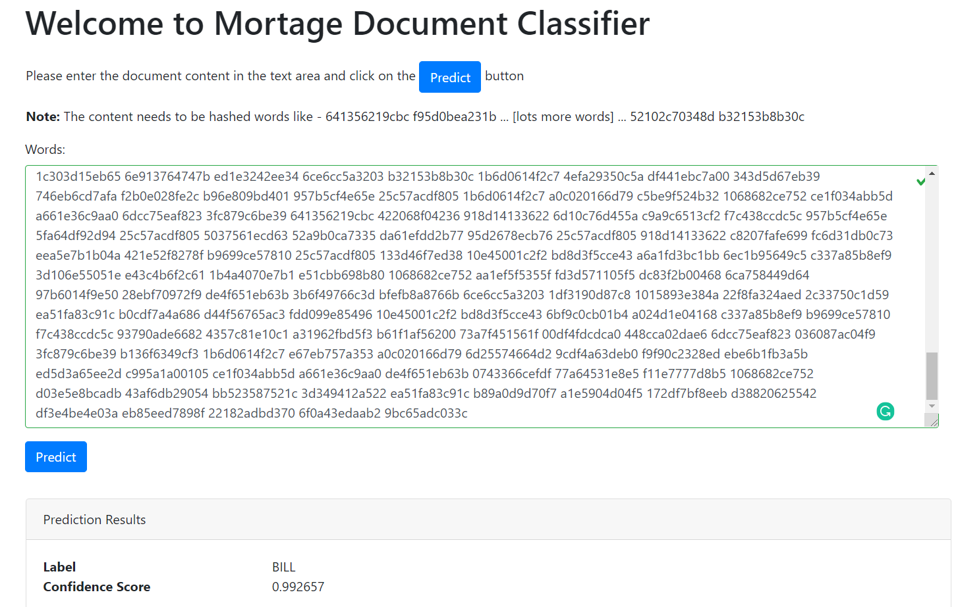
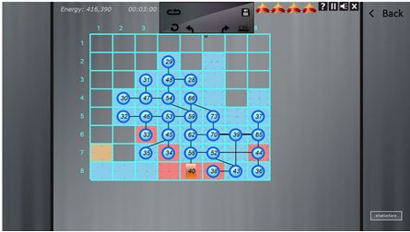
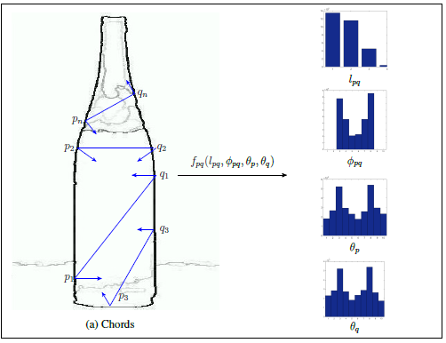
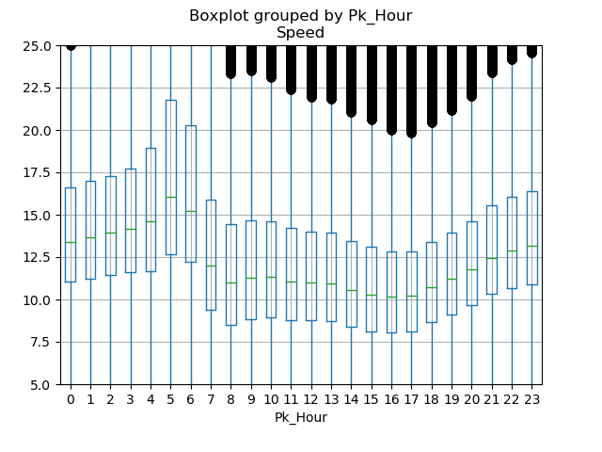
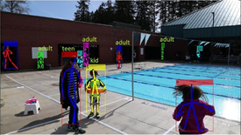
About Me
B. E. (Nagpur University)
M.S. (University of North Texas), Thesis - Object detection using shape
Ph.D. (Kansas State University), Dissertation - Image Privacy Prediction
Centre for Development of Advanced Computing (C-DAC)
Content Based Image Retrieval
Quick Heal Technologies
Malware Scan Engine using ML
Research Assistant
Obtained compact grid for structurally similar graphs.
Internship (Intel Corporation)
Age classification
Health and Wellness solutions recommendations
Other projects
Abstract Tag analysis
Document Classification
New York City Taxi data anlysis

Slide 3

Why Image Privacy Prediction?
Rapid increase in social media cause threat to user’s privacy.
Many users share many private images without realizing the consequences of an unwanted disclosure.
Users rarely change default privacy settings, which could jeopardize their privacy.
Current social networking sites do not assist users in making privacy decisions.
Manually assigning privacy settings to each image can be cumbersome.
Image Privacy Prediction suggests privacy setting for images and can help avoid a possible loss of users’ privacy.

Slide 4
The Importance of Image Privacy Prediction
Identifying private or sensitive content from images is inherently difficult.
owners' personality traits
level of awareness
Still, images' privacy is not purely subjective and generic patterns of privacy exist.
Researchers showed that generic patterns of images' privacy can be automatically identified when a large set of images are considered for analysis.
Researchers investigated binary prediction models based on user tags and image content features such as SIFT (Scale Invariant Feature Transform) and RGB (Red Green Blue) (Zerr et al., 2012; Squicciarini, Caragea, and Balakavi, 2014).
More recently, Tran et al. (2016 ) explored privacy frameworks that leverage the benefits of Convolutional Neural Networks (CNNs) for object recognition.
Intuitively, the objects present in images significantly impact images' privacy.

Slide 5
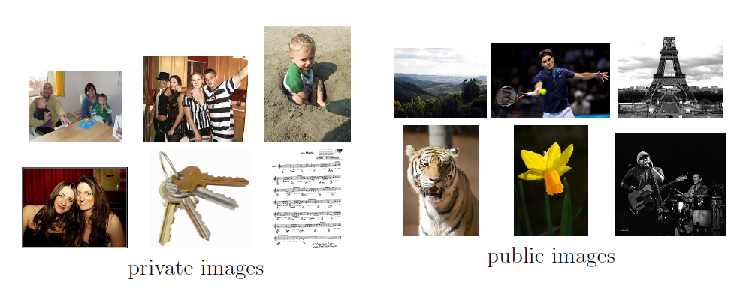
Examples of images manually identified as private and public

Slide 6
Research Objective
Can we generate a generic model that can provide prevalent privacy settings?
Can we take advantage of CNN to derive promising features that can identify private content in images shared online?
Do these features better discriminate between the public and private privacy classes than the existing features?
How well these features generalize over the unseen images?
Can we use multi-modal information associated with online images to identify sensitive content more accurately?

Slide 7
Main Contributions of my Research
An analysis of various “deep” feature representations for image privacy prediction (i.e., for predicting the class of an image as private or public). Unlike previous works, we explore features that can be directly obtained from a pre-trained CNNs for privacy prediction. (Tonge and Caragea, 2016, 2018 AAAI) and (Tonge and Caragea, 2018 WWW Companion).
An extensive study to carefully identify the CNN architectures and features derived from these CNNs that can adequately predict the class of an image as private or public. (Tonge and Caragea, 2019 TWEB (submitted)).
A privacy-aware approach to automatic image tagging, that aims at improving the quality of user annotations (or user tags), while also preserving the images' original privacy sharing patterns. (Tonge, Caragea, and Squicciarini 2018 HT) and (Tonge and Caragea, 2019 TIST (accepted)).
A novel approach that dynamically fuses multi-modal information of online images, derived through Convolutional Neural Networks (CNNs), to adequately identify the sensitive image content. (Tonge and Caragea, 2019 AAAI, WWW (accepted)).

Slide 8
Outline
The Use of “Deep” Features for Online Image Sharing.
Object and Scene Features
Dynamic Deep Multi-modal Fusion for Image Privacy Prediction.
Combining object, scene and user tags.
Summary and Future Directions

Slide 9
Outline
The Use of “Deep” Features for Online Image Sharing.
Object and Scene Features
Dynamic Deep Multi-modal Fusion for Image Privacy Prediction.
Combining object, scene and user tags.
Summary and Future Directions

Slide 10
“Deep” Features
Motivation:
CNN-based features worked well.
A qualitative analysis of features extracted from various layers of deep CNNs is not entirely explored for privacy and sharing needs of users' uploaded images.
Object and Scene

Slide 11
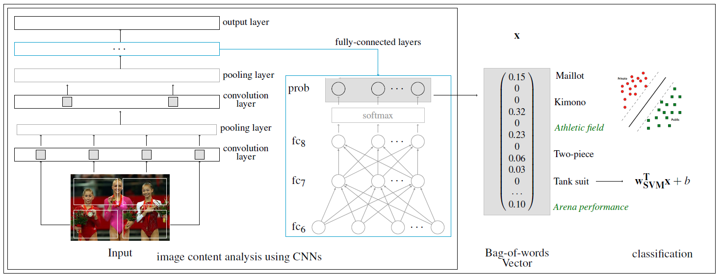
Feature Engineering

Slide 12
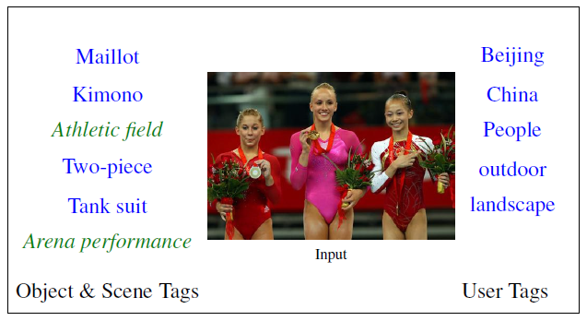
Feature Engineering Cont…

Slide 13
Dataset
Evaluated approach on a subset of 32,000 Flickr images sampled from the PicAlert dataset (Zerr et al., 2012).
PicAlert consists of Flickr images on various subjects, which are manually labeled as public or private by external viewers.
The dataset is split in train and test sets of 10,000 and 22,000 images, respectively.
The public and private images are in the ratio of 3:1 in both train and test.

Slide 14
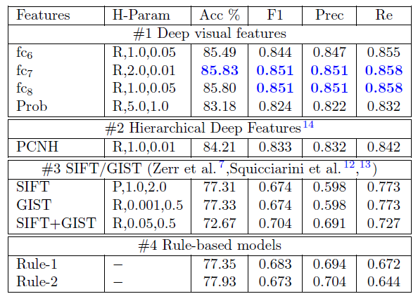
Deep visual features vs. Baselines
Experiments and Results

Slide 15
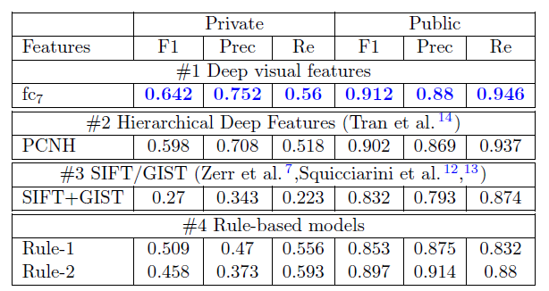
Deep visual features vs. Baselines Class specific performance
Experiments and Results

Slide 16
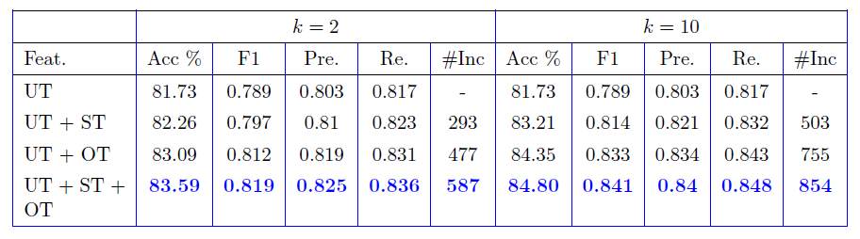
Deep Image Tags
Experiments and Results

Slide 17
Outline
The Use of “Deep” Features for Online Image Sharing.
Object and Scene Features
Dynamic Deep Multi-modal Fusion for Image Privacy Prediction.
Combining object, scene and user tags.
Summary and Future Directions

Slide 18
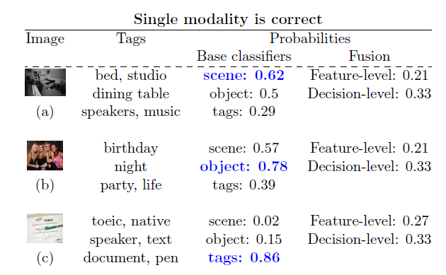
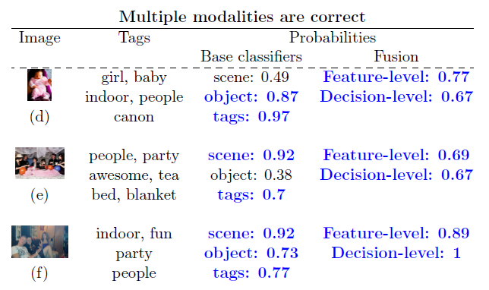
Motivation

Slide 19
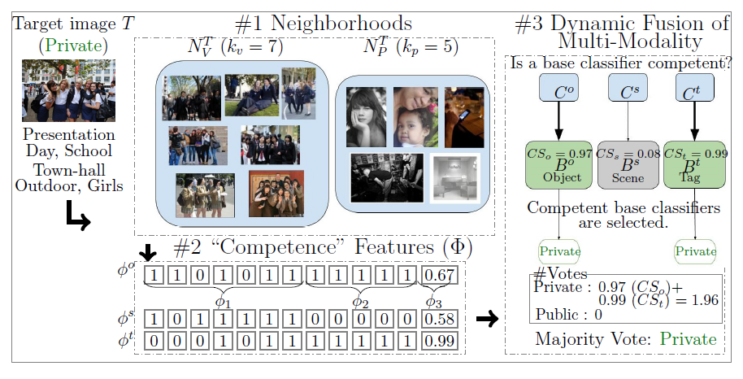
Dynamic Multi-modal Fusion

Slide 20
Dataset
D^{T} – 15,000 images
DE – 10,000 images
Test – 7,000 images

Slide 21
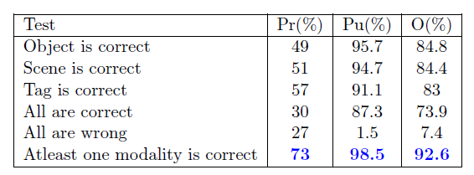
Exploratory Analysis

Slide 22
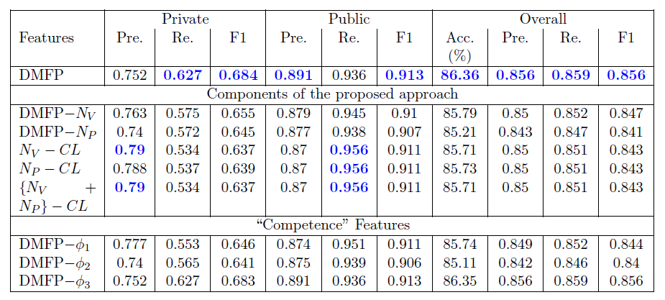
Evaluation of the DMFP
Experiments and Results

Slide 23
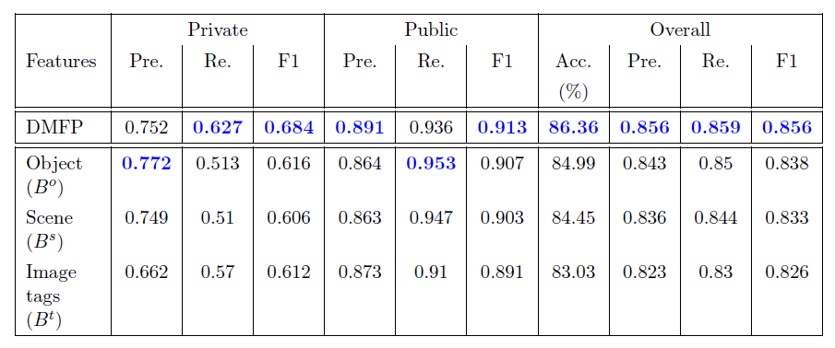
DMFP vs. Base Classifiers
Experiments and Results

Slide 24
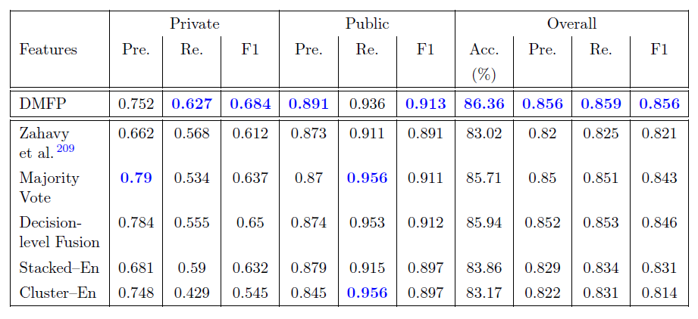
DMFP vs. Baselines
Experiments and Results

Slide 25
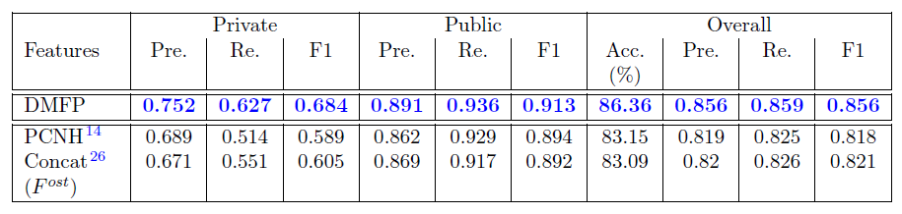
DMFP vs. Prior Privacy Prediction Works
Experiments and Results

Slide 26
Outline
The Use of “Deep” Features for Online Image Sharing.
Object and Scene Features
Dynamic Deep Multi-modal Fusion for Image Privacy Prediction.
Combining object, scene and user tags.
Summary and Future Directions

Slide 27
Summary
The Use of “Deep” Features for Online Image Sharing.
Object and Scene Features
deep features extracted from various CNN layers
Dynamic Deep Multi-modal Fusion for Image Privacy Prediction.
Estimate the competence of object, scene and image tag modalities
Dynamically identify the set of most competent modalities for a target image
to adequately predict the sensitive content.

Slide 28
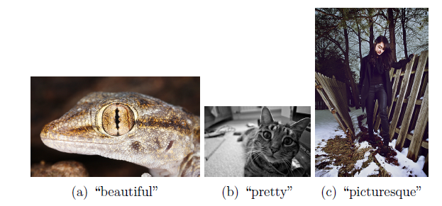
Future Directions
Hybrid approaches
Generic Privacy Models
Personalized Privacy Models
Architecture
Contextual Information
Image Owner
Owner’s Privacy Preferences
Visual Content
Describe and localize the sensitive content
Abstract Tags in Personalized Settings
“beautiful” and “pretty”
Dynamic Deep Multi-modal Fusion In Personalized Privacy Setting for Image Privacy Prediction.

Slide 29
Publications
Ashwini Tonge and Cornelia Caragea. “Dynamic Deep Multi-modal Fusion for Image Privacy Prediction.” In: Proceedings of the 30th the Web conference (WWW 2019)
Ashwini Tonge and Cornelia Caragea. “Dynamic Deep Multi-modal Fusion for Image Privacy Prediction.” In: Proceedings of the 33rd American Association for Artificial Intelligence (AAAI 2019), Student Abstract and Poster Program, USA, 2019
Ashwini Tonge and Cornelia Caragea. "Image Privacy Prediction Using Deep Neural Networks." In: ACM Transactions on the Web (ACM TWeb 2019), 2019 (submitted).
Ashwini Tonge and Cornelia Caragea. “Privacy-Aware Tag Recommendation for Accurate Image Privacy Prediction." In: ACM Transactions on Intelligent Systems and Technology (ACM TIST 2019), 2019 (accepted).
Ashwini Tonge, Cornelia Caragea and Anna Squicciarini. “Privacy-Aware Tag Recommendation for Image Sharing.” In: Proceedings of the 29th ACM conference on Hypertext and Social Media (HT 2018), Baltimore, USA, 2018.
Ashwini Tonge and Cornelia Caragea. 2018 “On the Use of Deep Features for Online Image Sharing.” In WWW’18 Companion: The 2018 Web Conference Companion, Lyon, France.
Ashwini Tonge. "Identifying Private Content for Online Image Sharing." In: Proceedings of the 32nd American Association for Artificial Intelligence (AAAI 2018), Doctoral Consortium, USA, 2018.
Ashwini Tonge and Cornelia Caragea. "Uncovering Scene Context for Predicting Privacy of Online Shared Images." In: Proceedings of the 32nd American Association for Artificial Intelligence (AAAI 2018), Student Abstract and Poster Program, USA, 2018.
Ashwini Tonge and Cornelia Caragea. "Image Privacy Prediction Using Deep Features." In: Proceedings of the 30th American Association for Artificial Intelligence (AAAI 2016), Student Abstract and Poster Program, Phoenix, Arizona, USA, 2016.

Slide 30
References
Kaiming He, Xiangyu Zhang, Shaoqing Ren, and Jian Sun. Deep residual learning for image recognition. In 2016 IEEE Conference on Computer Vision and Pattern Recognition, CVPR 2016, Las Vegas, NV, USA.
Krizhevsky, Alex, Ilya Sutskever, and Geoffrey E. Hinton (2012). “ImageNet Classification with Deep Convolutional Neural Networks”. In: Advances in Neural Information Processing Systems 25. Ed. by F. Pereira et al. Curran Associates, Inc., pp. 1097–1105.
Ameesh Makadia, Vladimir Pavlovic, and Sanjiv Kumar. A new baseline for image annotation. In Computer Vision ECCV 2008. Springer Berlin Heidelberg.
Minmin Chen, Alice Zheng, and Kilian Q. Weinberger. Fast image tagging. In Proceedings of the 30th International Conference on Machine Learning. ICML, January 2013.
Russakovsky, Olga et al. (2015). “ImageNet Large Scale Visual Recognition Challenge”.In:IJCV, pp. 1–42.
Shi, Yue, Martha Larson, and Alan Hanjalic (2014). “Collaborative Filtering Beyond the User-Item Matrix: A Survey of the State of the Art and Future Challenges”. In: ACM Comput. Surv.
Simonyan, Karen and Andrew Zisserman (2014). “Very Deep Convolutional Networks for Large-Scale Image Recognition”. In: CoRRabs/1409.1556.
Squicciarini, Anna C., Cornelia Caragea, and Rahul Balakavi (2014). “Analyzing Images’ Privacy for the Modern Web”. In: Proceedings of the 25th ACM Conference on Hypertext and Social Media. HT ’14. Santiago, Chile: ACM, pp. 136–147.
Szegedy, Christian et al. (2014). “Going Deeper with Convolutions”. In: CoRRabs/1409.4842.
Tran, Lam et al. (2016). “Privacy-CNH: A Framework to Detect Photo Privacy with Convolutional Neural Network Using Hierarchical Features”. In: Proceedings of the Thirtieth AAAI Conference. Phoenix, Arizona, pp. 1317–1323.
Tom Zahavy, Abhinandan Krishnan, Alessandro Magnani, and Shie Mannor. Is a picture worth a thousand words? A deep multi-modal architecture for product classification in e-commerce. In AAAI. AAAI Press, 2018.
Zerr, Sergej et al. (2012). “Privacy-aware image classification and search”. In: Proceedings of the 35th international ACM SIGIR conference on Research and development in information retrieval. Portland, Oregon, USA: ACM.
Zhou, Bolei et al. (2016). “Places: An Image Database for Deep Scene Understanding”.In: arXiv preprint arXiv:1610.02055.

Slide 31

Thank you!
Questions?
Grant Support:
7/16/2019
31

Slide 32
Links
https://ashwinitonge.github.io
https://akt-doc-classify.azurewebsites.net/
https://github.com/ashwinitonge
https://untangled.unt.edu/home.php
Notes:
48d657cd9861 fee60001e67a 4ce4bfb42e22 de9738ee8b24 3012dd989e4f 6e86c10fc88e f94e4dc858ab 17bc3e95a38f 73a7f451561f fdd099e85496 24d1ab9d7766 7a403ce898a7 25c57acdf805 48d657cd9861 4ce4bfb42e22 48d657cd9861 4ce4bfb42e22 1c303d15eb65 6e913764747b ed1e3242ee34 6bff0c8c1185 422068f04236 641356219cbc 2e1ebcc51c6f d8afd84c6fa9 7eb4767ef541 e244ebf791b5 641356219cbc b9699ce57810 6ce6cc5a3203 b32153b8b30c 1b6d0614f2c7 6bf9c0cb01b4 21e314d3afcc 21e314d3afcc 772ca81315b6 e07aa8e7bffa 0c14f6758cfb 25c57acdf805 6bf9c0cb01b4 a024d1e04168 c337a85b8ef9 586242498a88 1015893e384a 7ad052c5d4d6 97b6014f9e50 b208ae1e8232 094cb6be1e1f 4af3ac85a6ee cc55f8e6acaa b9699ce57810 131e0a24f74a 25c57acdf805 5037561ecd63 23344d9339f0 6d10c76d455a 079935e500e5 eeb571a1d4eb aaf05a0d2769 35cb78b49dd1 28c054c34af9 422068f04236 f52671c3d5de 957b5cf4e65e e6d2687290f1 7860028b1d17 25c57acdf805 95d2678ecb76 fe3fe35491b4 3f91c5ded960 61d55a85626a 133d46f7ed38 8f75273e5510 17b655441d36 a17edb60b591 e51cbb698b80 de4f651eb63b aa1ef5f5355f fd3d571105f5 7ad052c5d4d6 97b6014f9e50 10a1e91f6855 3b6f49766c3d bfefb8a8766b eb51798a89e1 e43c4b6f2c61 48d657cd9861 3012dd989e4f 31cbd98f4b3c 1169f8aa8528 529b38c25b1b 6ce6cc5a3203 6e86c10fc88e 48d657cd9861 b9699ce57810 f7c438ccdc5c ed5d3a65ee2d 10e45001c2f2 bd8d3f5cce43 6bf9c0cb01b4 a024d1e04168 c337a85b8ef9 ad4440ac97a5 6b343f522f78 e04a09c87692 ba3c06a73274 b7ab56536ec4 b0cdf7a4a686 6d10c76d455a d44f56765ac3 da61efdd2b77 6dbd5ceef3d1 25c57acdf805 6f0a43edaab2 ed5d3a65ee2d 172df7bf8eeb fdd099e85496 df3e4be4e03a 3d349412a522 b89a0d9d70f7 73a7f451561f 2a49f4793e03 3f009b69a735 b9699ce57810 5037561ecd63 3d106e55051e 73a7f451561f ed5d3a65ee2d fdd099e85496 ed5d3a65ee2d ea51fa83c91c ec5aa8fc6485 22f8fa324aed 0ade83d6e33b 2c33750c1d59 1df3190d87c8 95d2678ecb76 1015893e384a 25c57acdf805 25c57acdf805 6d10c76d455a 95d2678ecb76 54709b24b45f fb2cd24a447a afb1e3806fc1 de9738ee8b24 3d106e55051e 8754554be158 b0cdf7a4a686 d44f56765ac3 6dbd5ceef3d1 6f0a43edaab2 172df7bf8eeb df3e4be4e03a 3d349412a522 2860902e8203 a0c020166d79 6dcc75eaf823 1b6d0614f2c7 a661e36c9aa0 54709b24b45f 25c57acdf805 3fc879c6be39 ce1f034abb5d e52882a7f2b7 e6b2450fd782 de9738ee8b24 ec56ff31bb7a 152937e52656 73a7f451561f fdd099e85496 3f009b69a735 59c340e874ef ed5d3a65ee2d 1015893e384a de9738ee8b24 422068f04236 f2b0e028fe2c 2e1ebcc51c6f d8afd84c6fa9 0ade83d6e33b 6d10c76d455a 5c02c2aaa67b d582f8281ac3 b7ab56536ec4 d493c688fb66 9b88c973ae02 21e314d3afcc 1c303d15eb65 6e913764747b ed1e3242ee34 54709b24b45f de9738ee8b24 1015893e384a 5be138559904 b6038e1f1809 d0d2006a8296 f7c438ccdc5c bf53f3bf8c14 6a01047db3ab 6bf9c0cb01b4 a024d1e04168 c337a85b8ef9 b9699ce57810 fdd099e85496 10e45001c2f2 bd8d3f5cce43 6dbd5ceef3d1 6f0a43edaab2 172df7bf8eeb df3e4be4e03a 3d349412a522 b89a0d9d70f7 3d106e55051e b0cdf7a4a686 d44f56765ac3 ea51fa83c91c 73a7f451561f 2c33750c1d59 1015893e384a 22f8fa324aed a17edb60b591 e51cbb698b80 de4f651eb63b aa1ef5f5355f fd3d571105f5 7ad052c5d4d6 97b6014f9e50 10a1e91f6855 3b6f49766c3d bfefb8a8766b 9bc65adc033c e43c4b6f2c61 1df3190d87c8 b9699ce57810 f7c438ccdc5c 10e45001c2f2 bd8d3f5cce43 6bf9c0cb01b4 a024d1e04168 c337a85b8ef9 d0d2006a8296 6a01047db3ab 67c744b2956e e51cbb698b80 1068682ce752 aa1ef5f5355f fd3d571105f5 dc83f2b00468 6ca758449d64 97b6014f9e50 28ebf70972f9 de4f651eb63b 3b6f49766c3d bfefb8a8766b 10e45001c2f2 e43c4b6f2c61 bf53f3bf8c14 1df3190d87c8 b6038e1f1809 1015893e384a 22f8fa324aed 2c33750c1d59 ea51fa83c91c 73a7f451561f fdd099e85496 3d349412a522 b89a0d9d70f7 172df7bf8eeb df3e4be4e03a 6dbd5ceef3d1 6f0a43edaab2 b0cdf7a4a686 d44f56765ac3 3d106e55051e ea51fa83c91c 2a6fbe672600 a1e5904d04f5 d38820625542 586242498a88 eb85eed7898f eeb86a6a04e4 448cca02dae6 75199e110c91 cede998708f7 1ab34730c1e0 d5e335b0e32e 54709b24b45f eeb86a6a04e4 3d106e55051e 48cb187f082e e51cbb698b80 1068682ce752 aa1ef5f5355f fd3d571105f5 7ad052c5d4d6 97b6014f9e50 28ebf70972f9 de4f651eb63b 3b6f49766c3d bfefb8a8766b 97b6014f9e50 e43c4b6f2c61 1df3190d87c8 8d21095e8690 25c57acdf805 ea51fa83c91c 5d7641b096f0 73a7f451561f fdd099e85496 1015893e384a 22f8fa324aed 2c33750c1d59 957b5cf4e65e b9699ce57810 92335da34e06 f9f90c2328ed b1abddb99d7a ebe6b1fb3a5b f95d0bea231b ce1f034abb5d 6dbd5ceef3d1 2e1ebcc51c6f d8afd84c6fa9 5fa62998872f 6f0a43edaab2 b0cdf7a4a686 d44f56765ac3 3d349412a522 4249f2cf5d31 b89a0d9d70f7 f0fd45d01d0a 172df7bf8eeb df3e4be4e03a 641356219cbc 25c57acdf805 b61f1af56200 641356219cbc 036087ac04f9 b9699ce57810 6ce6cc5a3203 b32153b8b30c 1b6d0614f2c7 422068f04236 641356219cbc bfa7dfe64c4c 42ca5ffeb7d2 5e99d31d8fa4 e67eb757a353 6d25574664d2 25c57acdf805 9cdf4a63deb0 b136f6349cf3 43c123049e3b fe081ae57a8b fb2cd24a447a bac08c841a05 f9fc998ffd7e f11e7777d8b5 a95708b29bf1 de4f651eb63b 0c14f6758cfb 5d7641b096f0 93790ade6682 b9699ce57810 4357c81e10c1 10e45001c2f2 6ce6cc5a3203 1b6d0614f2c7 2cbc2b5e61bb 92335da34e06 a31962fbd5f3 7ad052c5d4d6 97b6014f9e50 b208ae1e8232 772ca81315b6 e07aa8e7bffa b814d9d78802 eca16ee06b98 586242498a88 b73e657498f2 586242498a88 1015893e384a 586242498a88 10e45001c2f2 eeb86a6a04e4 d38820625542 54115f01f96c 2e1ebcc51c6f 4e4bc62c7e27 d5f4611022c1 b73e657498f2 3f009b69a735 d38820625542 d38820625542 a1e5904d04f5 ea51fa83c91c b9699ce57810 6bf9c0cb01b4 a024d1e04168 c337a85b8ef9 448cca02dae6 eb85eed7898f 801b08c3d068 35cb78b49dd1 28c054c34af9 397c6b6c68bb d38820625542 b814d9d78802 eca16ee06b98 73a7f451561f fdd099e85496 25c57acdf805 31fdb28ad1d7 ce1f034abb5d 2e1ebcc51c6f d8afd84c6fa9 17b655441d36 fe3fe35491b4 3f91c5ded960 aaba399b8500 133d46f7ed38 e6d2687290f1 7860028b1d17 131e0a24f74a 4ce4bfb42e22 ea51fa83c91c 25c57acdf805 fb2cd24a447a 6ce6cc5a3203 b32153b8b30c 1b6d0614f2c7 4ce4bfb42e22 a87473e878c1 4ce4bfb42e22 09dfec4d547d 48d657cd9861 586242498a88 ed5d3a65ee2d 25c57acdf805 133d46f7ed38 fb2cd24a447a f816f047c0db 641356219cbc cf4fc632eed2 ed5d3a65ee2d 98d0d51b397c 48d657cd9861 f7ae6f8257da f52671c3d5de ed5d3a65ee2d 42e393bc7d8e b7a0f56f6ce8 eeb86a6a04e4 1c303d15eb65 6e913764747b ed1e3242ee34 6ce6cc5a3203 b32153b8b30c 1b6d0614f2c7 4efa29350c5a df441ebc7a00 343d5d67eb39 746eb6cd7afa f2b0e028fe2c b96e809bd401 957b5cf4e65e 25c57acdf805 1b6d0614f2c7 a0c020166d79 c5be9f524b32 1068682ce752 ce1f034abb5d a661e36c9aa0 6dcc75eaf823 3fc879c6be39 641356219cbc 422068f04236 918d14133622 6d10c76d455a c9a9c6513cf2 f7c438ccdc5c 957b5cf4e65e 5fa64df92d94 25c57acdf805 5037561ecd63 52a9b0ca7335 da61efdd2b77 95d2678ecb76 25c57acdf805 918d14133622 c8207fafe699 fc6d31db0c73 eea5e7b1b04a 421e52f8278f b9699ce57810 25c57acdf805 133d46f7ed38 10e45001c2f2 bd8d3f5cce43 a6a1fd3bc1bb 6ec1b95649c5 c337a85b8ef9 3d106e55051e e43c4b6f2c61 1b4a4070e7b1 e51cbb698b80 1068682ce752 aa1ef5f5355f fd3d571105f5 dc83f2b00468 6ca758449d64 97b6014f9e50 28ebf70972f9 de4f651eb63b 3b6f49766c3d bfefb8a8766b 6ce6cc5a3203 1df3190d87c8 1015893e384a 22f8fa324aed 2c33750c1d59 ea51fa83c91c b0cdf7a4a686 d44f56765ac3 fdd099e85496 10e45001c2f2 bd8d3f5cce43 6bf9c0cb01b4 a024d1e04168 c337a85b8ef9 b9699ce57810 f7c438ccdc5c 93790ade6682 4357c81e10c1 a31962fbd5f3 b61f1af56200 73a7f451561f 00df4fdcdca0 448cca02dae6 6dcc75eaf823 036087ac04f9 3fc879c6be39 b136f6349cf3 1b6d0614f2c7 e67eb757a353 a0c020166d79 6d25574664d2 9cdf4a63deb0 f9f90c2328ed ebe6b1fb3a5b ed5d3a65ee2d c995a1a00105 ce1f034abb5d a661e36c9aa0 de4f651eb63b 0743366cefdf 77a64531e8e5 f11e7777d8b5 1068682ce752 d03e5e8bcadb 43af6db29054 bb523587521c 3d349412a522 ea51fa83c91c b89a0d9d70f7 a1e5904d04f5 172df7bf8eeb d38820625542 df3e4be4e03a eb85eed7898f 22182adbd370 6f0a43edaab2 9bc65adc033c

Slide 33
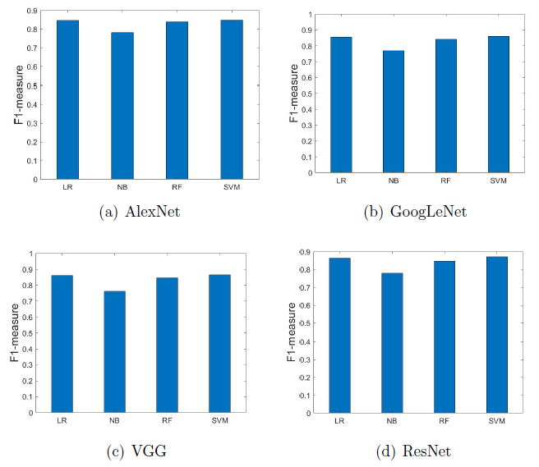
Classification Experiments for Features Derived From Pre- Trained CNNs

Slide 34
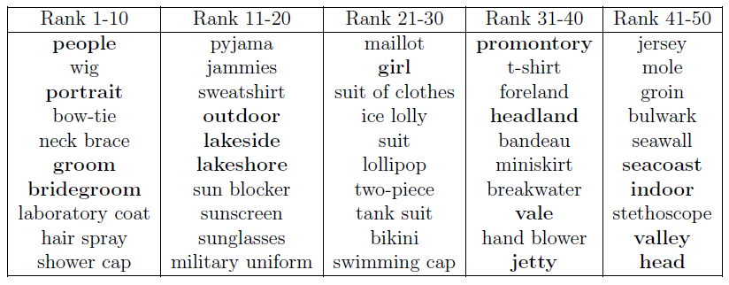
Analysis of Image tags

Slide 35
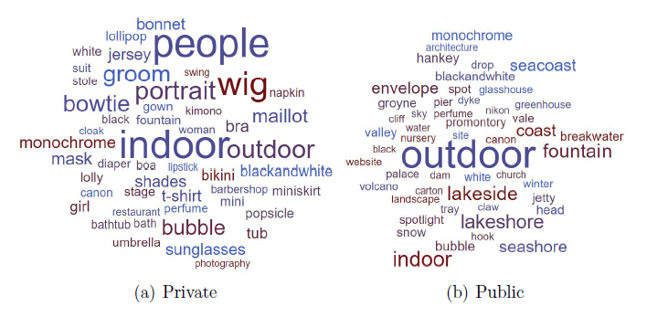
Tag clouds

Slide 36
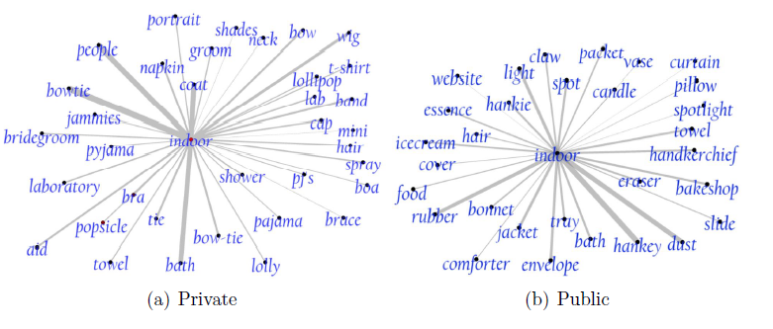
Tag association graph

Slide 37
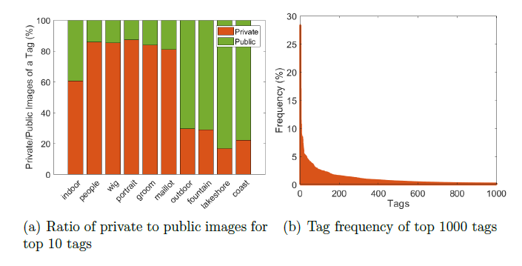
Analysis of frequently occurring tags

Slide 38
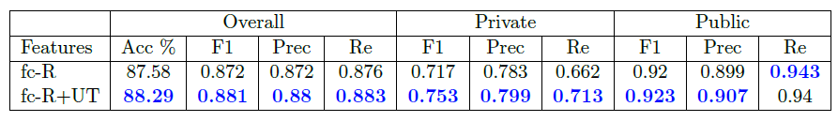
Results for the combination of visual and tag features

Slide 39
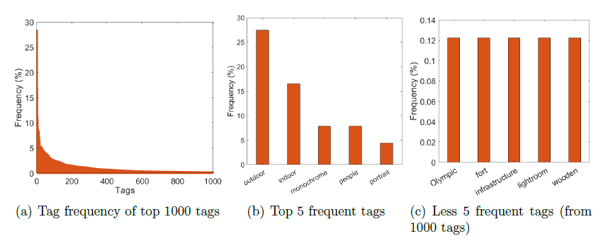
Tag Frequency

Slide 40
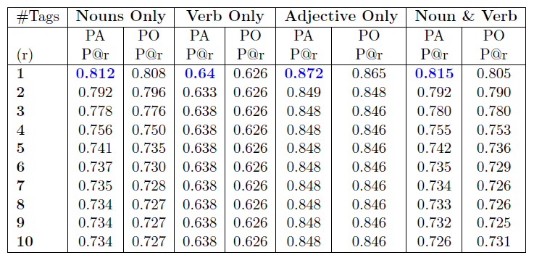
Quality Assessment of Recommended Tags

Slide 41
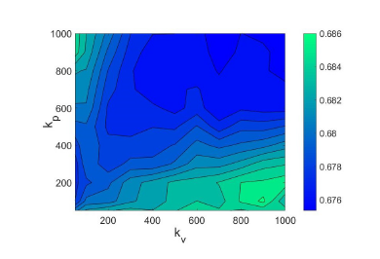
Impact of Parameters k_{v} and k_{p}
Experiments and Results

Slide 42
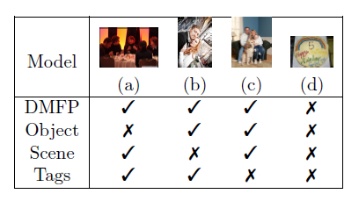
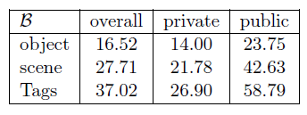
Predictions and Error Analysis
Experiments and Results

Slide 43
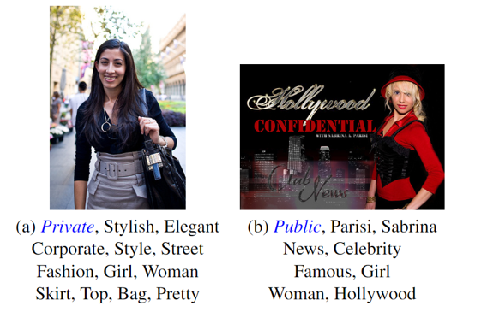
Motivation

Slide 44
Privacy-aware Tag Recommendation
Our approach draws ideas from collaborative filtering (CF).
The analogy with conventional CF methods is that images correspond to users and tags correspond to items.
Base our models on the assumption that privacy-aware similar images possess similar tags.
Images can be represented using two different views or feature types:
image visual content
image tags

Slide 45
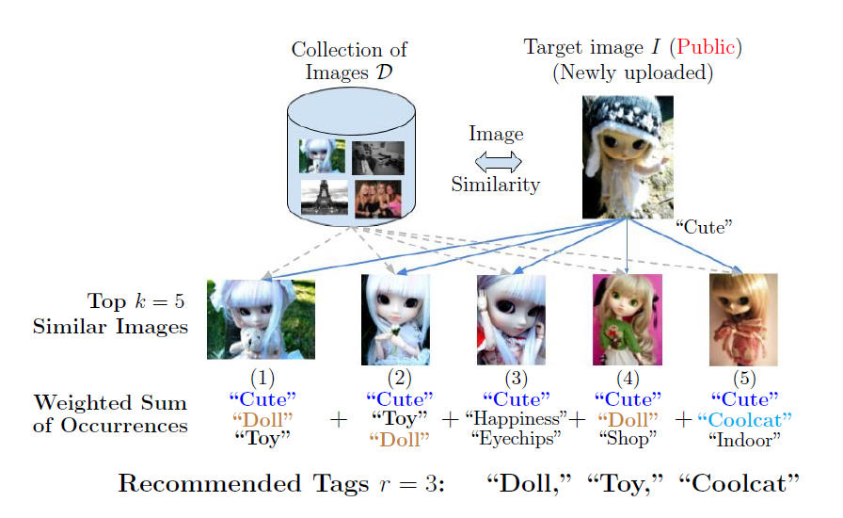
Algorithm Illustration - I

Slide 46
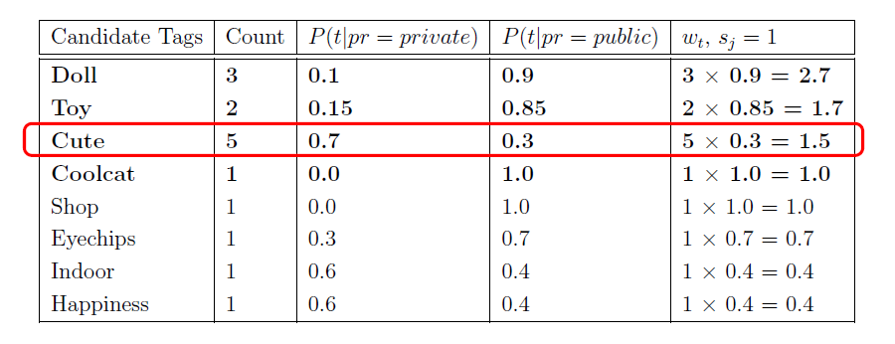
Algorithm Illustration - II

Slide 47
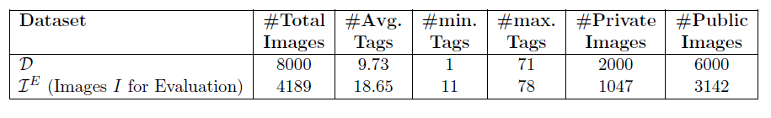
Dataset
For each image I in IE, we randomly split its set of tags into two subsets.
Visible
hidden.
The visible subset is used to compute the similarity between the visible subset of the target image I in IE with the original set of tags of images in D.
The hidden subset is considered as gold standard for the evaluation of recommended tags.

Slide 48
Experiments and Results
The quality of recommended tags is determined by:
Whether these tags hint to specific image privacy settings.
Whether these tags are good enough to describe the content of an image.
We adopt two evaluation mechanisms:
Image Privacy Prediction.
Determine if the recommended tags are able to enhance the training set and learn better privacy characteristics.
Train: 3,689 and Test: 500.
Tag relevance
We compare the recommended tags against the ground-truth, i.e., the hidden set of tags, and also evaluate their quality through crowd-sourcing.
500 images as Drel.

Slide 49
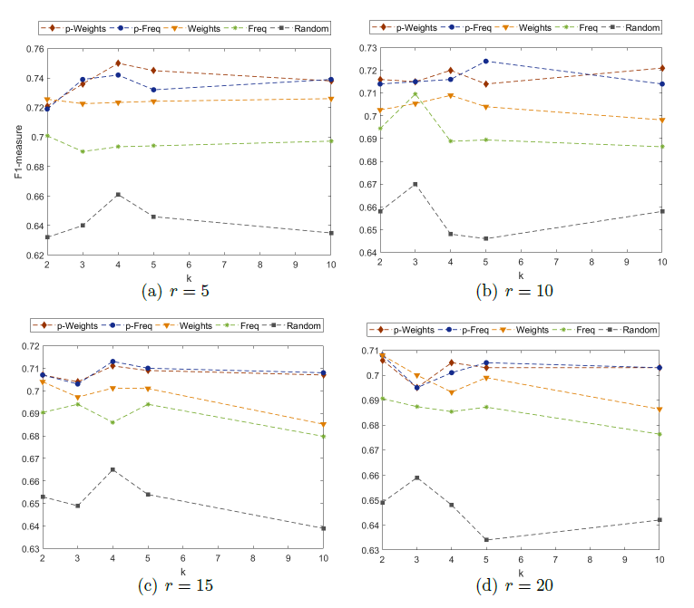
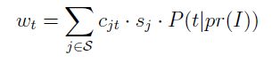
Evaluation of Recommended Tags by Privacy Prediction
Experiments and Results

Slide 50
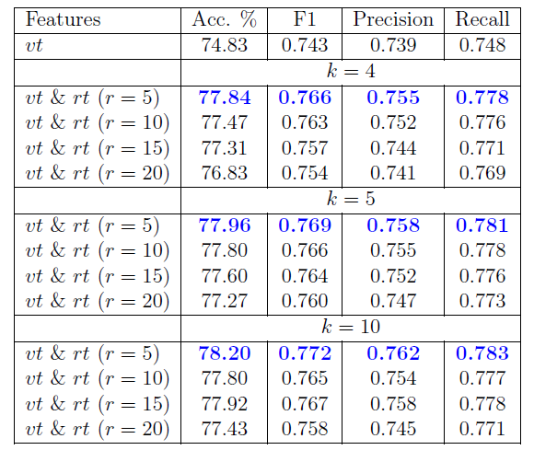
Evaluation of Recommended Tags by Privacy Prediction
Experiments and Results

Slide 51
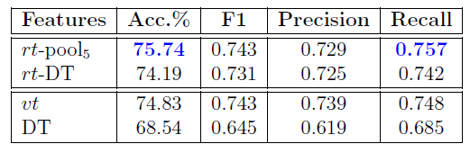
Cold Start
Experiments and Results

Slide 52
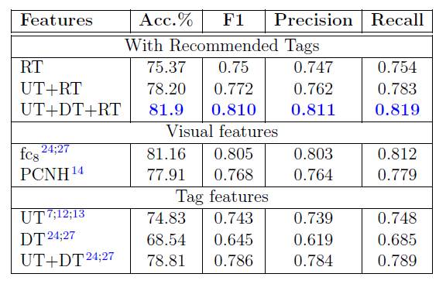
Privacy-aware Tag Recommendation vs. Prior Privacy Prediction Works
Experiments and Results

Slide 53
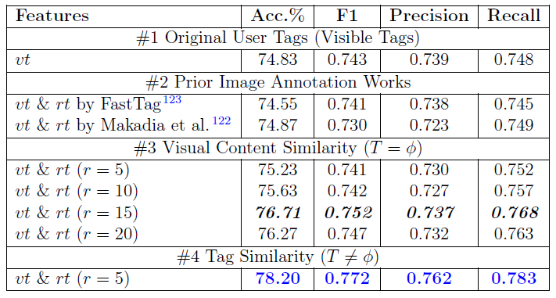
Privacy-aware Tag Recommendation vs. Prior Image Annotation Works
Experiments and Results

Slide 54
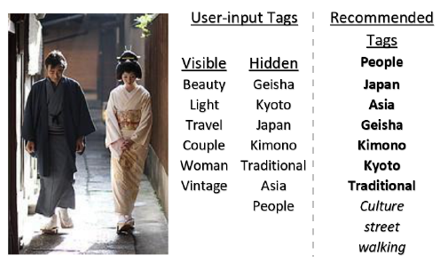
Quality Assessment of Recommended Tags
Experiments and Results

Slide 55
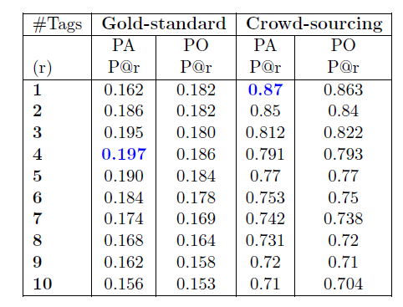
Quality Assessment of Recommended Tags
Experiments and Results

Slide 56
Outline
The Use of “Deep” Features for Online Image Sharing.
Object and Scene Features
DeepPrivate Features For Image Privacy Prediction.
CNN architecture comparison
Dynamic Deep Multi-modal Fusion for Image Privacy Prediction.
Combining object, scene and user tags.
Summary and Future Directions

Slide 57
DeepPrivate Features
Motivation:
The choice of the CNN architecture used in prior works is limited to AlexNet (Krizhevsky, Sutskever, and Hinton, 2012)
Given the strengths of deeper CNN architectures for object recognition (Szegedy et al., 2014; Simonyan and Zisserman, 2014; He et al., 2016), deeper feature representations exists.
Can these features potentially improve the performance of the image privacy prediction?

Slide 58
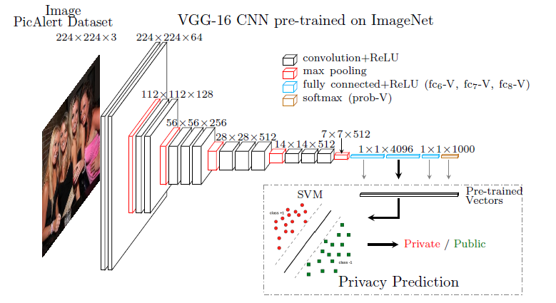
Pre-trained CNN

Slide 59
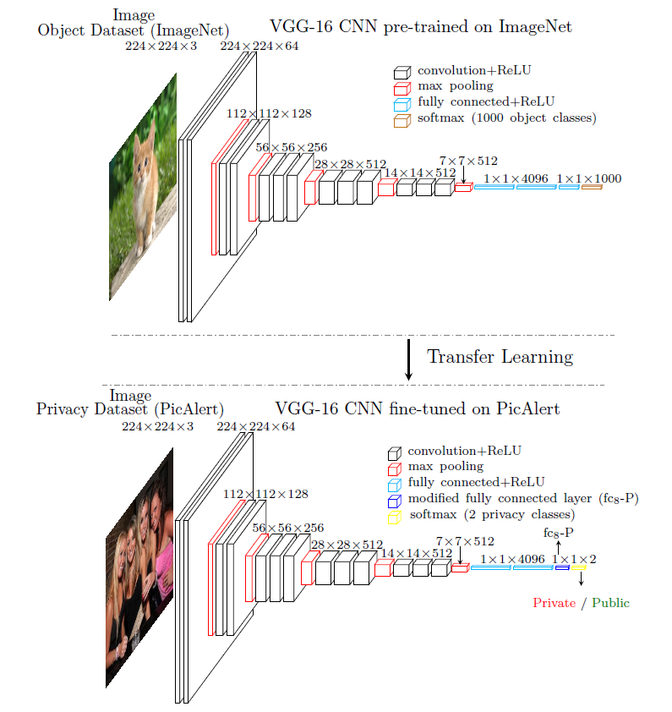
Fine-tuned CNN

Slide 60
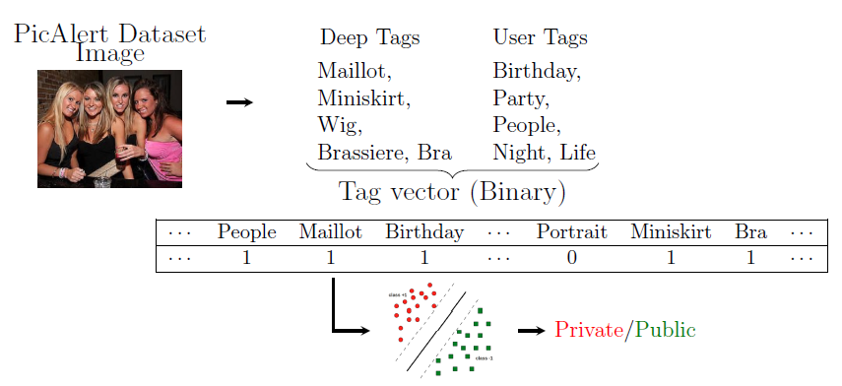
Bag-of-Tags

Slide 61
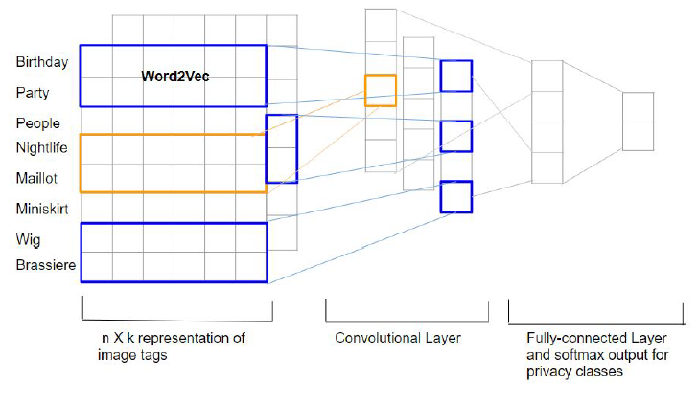
Tag CNN

Slide 62
Dataset
Train – 27,000
Test – 5000

Slide 63
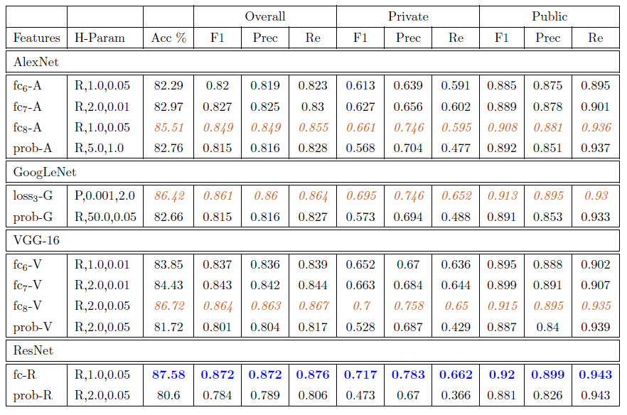
The impact of the network architecture on the privacy prediction
Experiments and Results

Slide 64
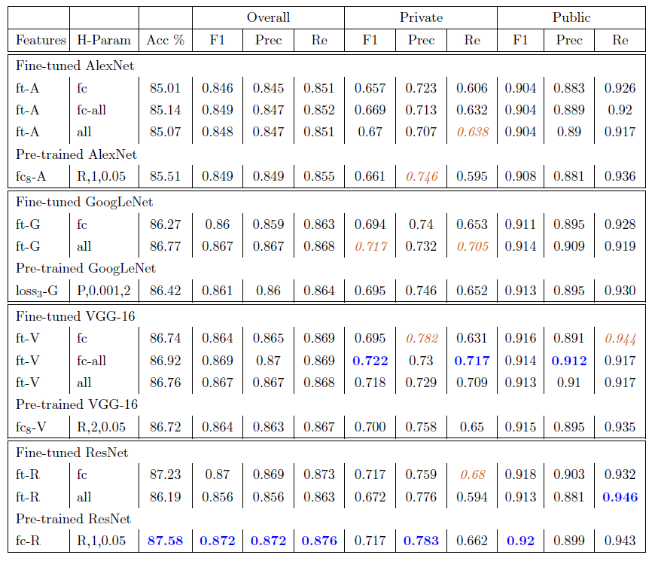
Fine-tuned vs. Pretrained networks.

Slide 65
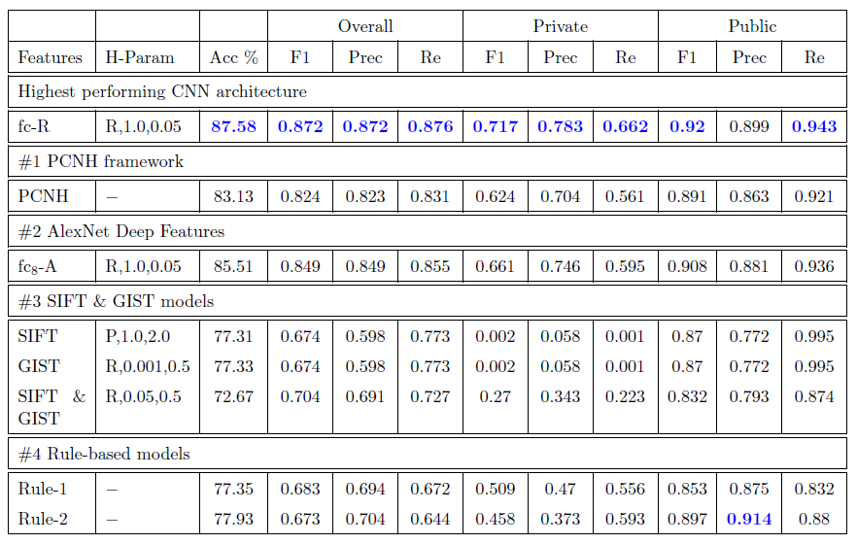
DeepPrivate features vs. Baselines

Slide 66

Evaluation of tag features for privacy prediction

Slide 67

Privacy predictions obtained by image content encodings

